Slide 1
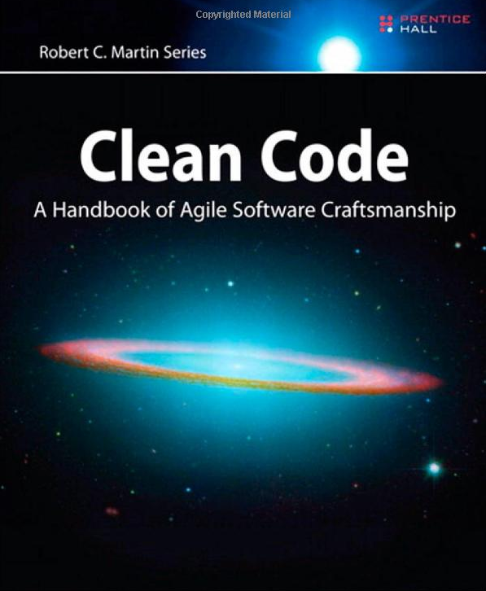
OnClean Code
Taming the spaghetti monster
Presented By:
Fernando Zamora
Copyright 2008 McLane Advanced Technologies, LLC

Slide 2
Agenda
What is clean code
Why it’s important
Philosophy
Cover a few topics on how to write cleaner code
Names
Functions
Comments
Read code
Have Fun – there is no such thing as perfect code!!!!!
Exercises

Slide 3
Clean Code What is it?
Testable and tested
Elegant
Efficient
Expressive
Expected
Readable
Minimal Dependencies
Maintainable
Self Documenting
Simple

Slide 4
Bad Code – What is it?
Inappropriate Information (Regions)
Obsolete Comments
Redundant Comments
Poorly Written Comments
Commented out code
Too many arguments
Output arguments
Flag arguments
Dead functions
Duplication
Incorrect Behavior and Boundaries
Code at wrong level of abstraction
Base classes depending on their derivatives
Too much information
….

Slide 5
Why is Clean Code Important
Maintains fast productivity
It is costly to own a mess
Productivity decreases asymptotically eventually down to 0
Boy Scout Rule: Leave the code better than you found it
As the old saying goes:"Write your code as if the person that's going to maintain it is a psychotic serial killer who knows where you live.“
Happier Developers

Slide 6
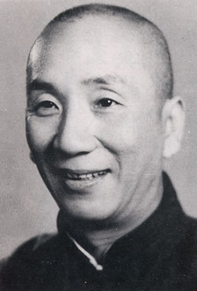
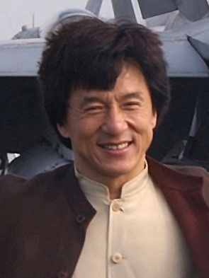
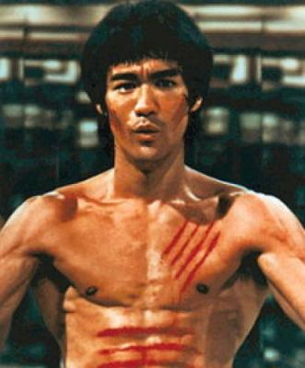


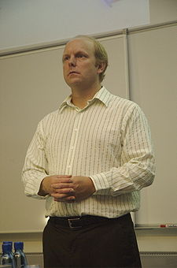
Philosophy
Just like martial arts has many masters with different styles, so does Clean Code **
Jeet Kune Do
Drunken Master?
Wing Chun
Code Complete
S.O.L.I.D
TDD

Slide 7
Philosophy
Principles and techniques
Code is a living design
Treat writing code as a craftsman
REFACTOR
S.O.L.I.D
DRY
TDD
Boy Scout

Slide 8
Choosing Names
Meaningful names
Avoid Disinformation – hp,
Avoid small variations in names – s1, s2
4. Meaningful Distinctions
if (!fundsAvailable || availableFunds < -0.004m)
5. Pronounceable Names - rptparam
6. Searchable Names – MAX_DAYS instead of 999
7. Avoid Encodings – e.g. Hungarian notation strName, strFName, Compiler
8. Function Names are verbs
9. Data fields are nouns

Slide 9
Choosing Names
Interfaces and implementations – IShapeFactory, ShapeFactory
Avoid mental mapping – i, a, b, c
Class names should have noun names
Functions should have verb names
With overloaded constructors use static factory methods instead
Don’t be cute – e.g. EatMyShorts instead of Abort
One word per concept – get, fetch, retrieve
Use solution domain names – JobsQueue
Use problem domain names –
Avoid gratuitous content – Gas Station Deluxe gsdAccount, gsdName, …
Method names should describe everything they do in their name
Hint: If your method name is funky than probably your implementation is as well

Slide 10
Exercises Part I
1. Create method with implementation
Class Name: you decide
Method Name: MeetsMinimumAgeRequirements
Return Value: boolean
Parameters: Date of Birth, Minimum Age, Today’s Date
Create a method that calls and protected method
void PlaceOrder(int qty)
Class Name (hint): Order Service
Method Name: Replenish
Return Value: void
Parameters: you decide
Hint: Ordering service must be determine how much to order based on existing quantity and optimum on hand quanities

Slide 11
Functions Rules
Small
Smaller
Do one thing
Do it well
Do it only
One level of abstraction
Read from the top down like a set of To paragraphs

Slide 12
Exercise Part 2 – Fix This Code
Scenario A: You have been tasked to find a bug in the code. The users have identified that users cannot log in. Whenever they try to login with a valid user name and password the system just stays on the login screen. Whenever they enter an invalid user or password they get a message indicating that the login is not valid.
Scenario B: The users have also complained that when logging in from the handheld, they don’t get a message in either case. Instead the application throws a time out exception without allowing them to log in.
You discovered the function where the bug occurs and you discover that the function is shared by both logins.

Slide 13
Exercise Part 2 – Fix This Code
public bool CheckLogin(string userNme, string pwd, out string msg)
{
bool result = false;
User usr = _repository.GetUser(userNme);
msg = string.Empty;
if(usr != null){
if(_passwdHashSvc.HashMatches(usr.PwdHash, pwd)){
result = true;
}
else{
msg = "Invalid user or password";
result = false;
}
}
else{
msg = "Invalid user or password";
result = false;
}
if(string.IsNullOrEmpty(msg)
MessageBox.Show(msg);
return false;
}

Slide 14
Function Rules
8. - Switch Statements
Reduce switch statements to single location by factory and polymorphism
Use polymorphic classes
9. Use Descriptive Names
Describe what the function is doing
Don’t be afraid to make it long
10. Be consistent in your names
11. Function Arguments
Ideal number is zero (nidalic)
One (monadic) – To transform is ok, but not as flag
Two (dyadic)
Three should be avoided where possible
12. Have no side effects
13. Return, Break, Continue do not have bad effect on small functions (Structured Programming)

Slide 15
Comments
1. Failure to express ourselves in code
Comments Lie
Comments are hard to maintain
The real truth is in the code
Don’t comment - Clean your code instead
1.
//Check to see if order qualifies for a discount
If( Order.Code = = DISCOUNT_ITEM &&
Order.CustomerType == PREFERRED_CUSTOMER)
2.
If(Order.QualifiesForDiscount())

Slide 16
Comments
if (_RCCde == "D” || _RCCde == "L” || _RCCde == "K”)
{
…Do something
}
//The function name is more expressive … using domain language
//Makes RecoverableItem searchable also
if (IsRecoverableItem())
{
…Do Something
}

Slide 17
Acceptable Comments
Acceptable Comments
Legal Comments – Copyright, etc
Informative Comments
Explanation of intent
Warning of consequences
TODO
Amplification
Self Documentation – Javadocs

Slide 18
Unacceptable Comments
1. Mumbling
Redundant
Misleading Comments
Mandated Comments
Journal Comments – Not necessary with source control systems**
Noise Comments
Position Markers
Closing Brace Comments – Shorter Functions Instead
Attributions by line – Use Source Control
Commented out code
Too Much Information
…

Slide 19
About Fernando Zamora
Sr. Software Engineer @ McLane Advanced Technologies
Personal Blog, Etc: http://fernandozamorajimenez.blogspot.com/
Email: fernando.zamora@mclaneat.com fernando.zamora.jimenez@gmail.com
Twitter: @fernandozamoraj
www.mclaneat.com
McLane Advanced Technologies
4001 Central Pointe Parkway
Temple, Texas 76504
800-988-5428
Copyright 2008 McLane Advanced Technologies, LLC

